Slide 1
Stakeholders in the MHC-PMS
Patients whose information is recorded in the system.
Doctors who are responsible for assessing and treating patients.
Nurses who coordinate the consultations with doctors
and administer some treatments.
Medical receptionists who manage patients’ appointments.
IT staff who are responsible for installing and maintaining the system.

Slide 2
Stakeholders in the MHC-PMS
A medical ethics manager who must ensure that the
system meets current ethical guidelines for patient care.
Health care managers who obtain management information from the system.
Medical records staff who are responsible for ensuring that system information can be maintained and preserved, and that record keeping procedures have been properly implemented.

Slide 3
4.6 Requirements validation
Concerned with demonstrating that the requirements define the system that the customer really wants.
Requirements error costs are high so validation is very important
Fixing a requirements error after delivery may cost up to 100
times the cost of fixing an implementation error.

Slide 4
Requirements checking
Validity. Does the system provide the functions which best support the customer’s needs?
Consistency. Are there any requirements conflicts?
Completeness. Are all functions required by the customer included?
Realism. Can the requirements be implemented given available budget and technology

Slide 5
Requirements validation techniques
Requirements reviews
Systematic manual analysis of the requirements.
Prototyping
Using an executable model of the system to check requirements.
Test-case generation
Developing tests for requirements to check testability.

Slide 6
4.7 Requirements management
Requirements management is the process of managing changing requirements during the requirements engineering process and system development.
New requirements emerge as a system is being developed and after it has gone into use.
You need to keep track of individual requirements and maintain links between dependent requirements so that you can assess the impact of requirements changes. You need to establish a formal process for making change proposals and linking these to system requirements.

Slide 7
Changing requirements
The business and technical environment of the system
always changes after installation.
New hardware may be introduced, it may be necessary to interface the system with other systems, business priorities may change (with consequent changes in the system support required), and new legislation and regulations may be introduced that the system must necessarily abide by.
The people who pay for a system and the users of that system are rarely the same people.
System customers impose requirements because of organizational and budgetary constraints. These may conflict with end-user requirements and, after delivery, new features may have to be added for user support if the system is to meet its goals.

Slide 8
Changing requirements
Large systems usually have a diverse user community, with many users having different requirements and priorities that may be conflicting or contradictory.
The final system requirements are inevitably a compromise between them and, with experience, it is often discovered that the balance of support given to different users has to be changed.

Slide 9
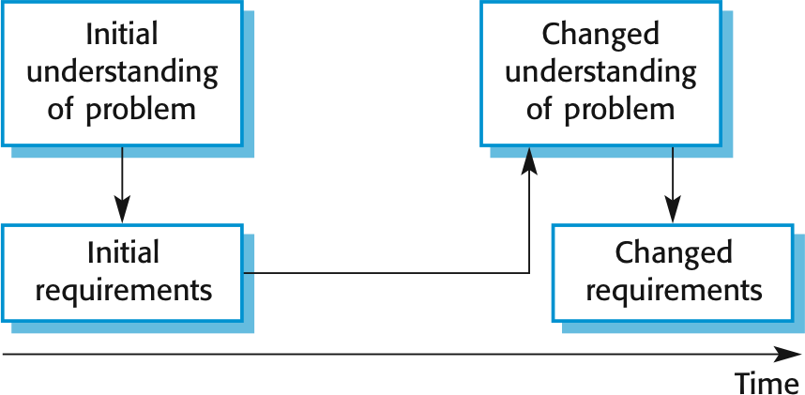
Requirements evolution

Slide 10
Topics covered
Context models
Interaction models
Behavioral models
Object Model

Slide 11
System modeling
System modeling is the process of developing abstract models of a system, with each model presenting a different view or perspective of that system.
System modeling has now come to mean representing a system using some kind of graphical notation, which is now almost always based on notations in the Unified Modeling Language (UML).
System modelling helps the analyst to understand the functionality of the system and models are used to communicate with customers.

Slide 12
Existing and planned system models
Models of the existing system are used during requirements engineering. They help clarify what the existing system does and can be used as a basis for discussing its strengths and weaknesses. These then lead to requirements for the new system.
Models of the new system are used during requirements engineering to help explain the proposed requirements to other system stakeholders.

Slide 13
System perspectives
You may develop different models to represent the system from different perspectives.
An interaction perspective, where you model the interactions between a system and its environment, or between the components of a system.
A structural perspective, where you model the organization of a system or the structure of the data that is processed by the system.
A behavioral perspective, where you model the dynamic behavior of the system and how it responds to events.

Slide 14
Context Models:
Context models are used to illustrate the operational context of a system.
They show what lies outside the system boundaries.
They shows how IT applications fit into the context of the people and the organization they serve.
Context models are sometimes called enterprise architecture models, sometimes high-level
design models and sometimes conceptual models.

Slide 15
System Context Diagram:
A System Context Diagram (SCD) in software engineering and systems engineering is a diagram that defines the boundary between the system, or part of a system, and its environment, showing the entities that interact with it.
This diagram is a high level view of a system.

Slide 16
System Boundaries:
System boundaries are established to define what is inside and what is outside the system.
They show other systems that are used or depend on the system being developed.

Slide 17
MHC-PMS has a simple context model that shows the patient
information system and the other systems in its environment.
MHC-PMS is connected to
Appointments system.
Patient record system with which it shares data.
Systems for management reporting and hospital bed
Statistics system that collects information for research.
allocation.
Prescription system to generate prescriptions for patients’ medication.

Slide 18
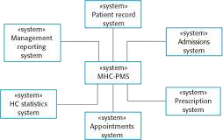
Context of MHC-PMS:

Slide 19
2: Automated-teller Machine(ATM)
It illustrats the structure of information system that include a bank auto-teller network.
Each atm is connected to
Account database
Local branch accounting system
Security system
Maintenance system to support machine maintenance.
Usage database that monitor how the network of atm is used
local branch counter system provide survices such as backup and printing.

Slide 20
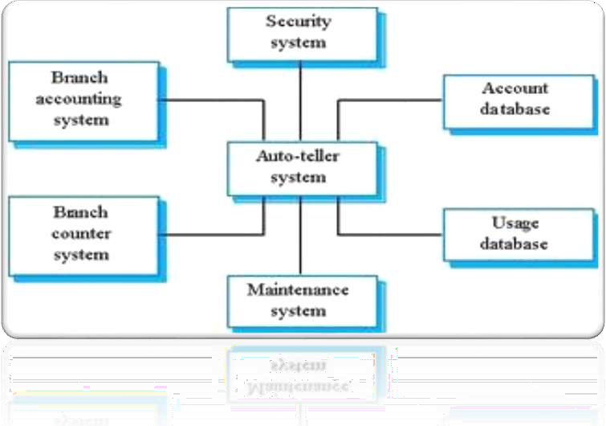
Context Of ATM:

Slide 21
Context models normally show that the environment includes several other automated systems.
However, they do not show the types of relationships between the systems in the environment and the system that is being specified.
Therefore, simple context models are used along with other models, such as business process models. These describe human and automated processes in which particular software systems are used.

Slide 22
Interaction models
This can be user interaction, which involves user inputs and outputs, interaction between the system being developed and other systems or interaction between the components of the system.
There are two interaction models
Use case modeling, which is mostly used to model interactions between a system and external actors (users or other systems).
Sequence diagrams, which are used to model interactions between system components, although external agents may also be included.

Slide 23
Use case modeling
Use case modeling was originally developed by Jacobson et al. (1993).
A use case can be taken as a simple scenario that describes what a user expects from a system.
Each use case represents a discrete task that involves external interaction with a system.

Slide 24

A use case in the MHC-PMS
use case from the MHC-PMS that represents the task of uploading data from the MHC-PMS to a more general patient record system.
Two actors are involved in the system
the operator
the patient record system

Slide 25
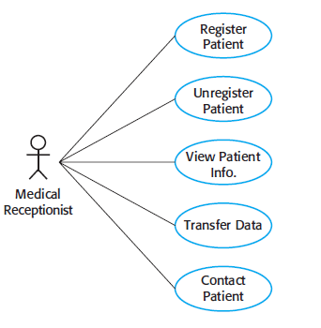
Use cases in the MHC-PMS involving the role ‘Medical Receptionist

Slide 26
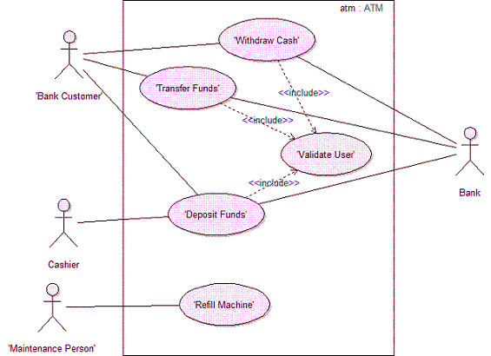
Usecase forATM

Slide 27
Sequence diagrams
Sequence diagrams in the UML are primarily used to model the interactions between the actors and the objects.
a sequence diagram shows the sequence of interactions that take place during a particular use case

Slide 28
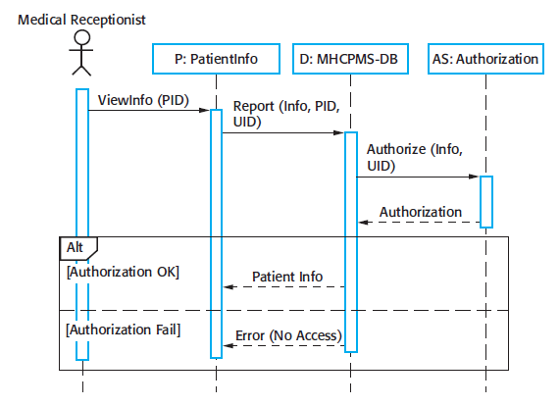
Sequence diagram for View patient information

Slide 29
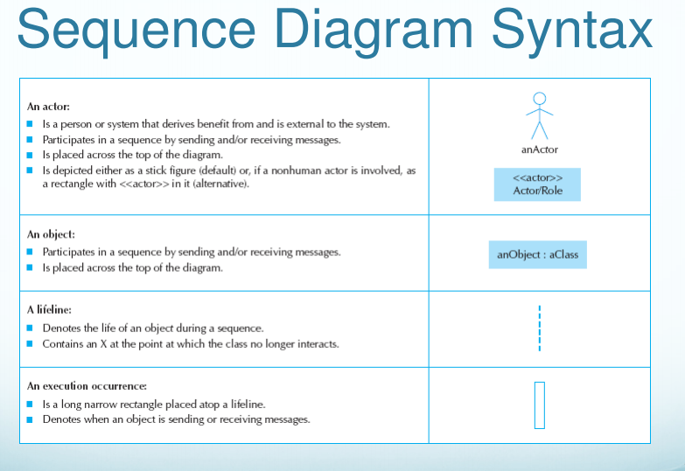

Slide 30
Behavioral models
Behavioural models are models of the dynamic behaviour of a system as it is executing.
They show what happens or what is supposed to happen when a system responds to a stimulus from its environment.
You can think of these stimuli as being of two types:
Data Some data arrives that has to be processed by the system.
Events Some event happens that triggers system processing. Events may have associated data, although this is not always the case.

Slide 31
Data-driven modeling
Data-driven models show the sequence of actions involved in processing input data and generating an associated output.
they show the entire sequence of actions that take place from an input being processed to the corresponding output,

Slide 32
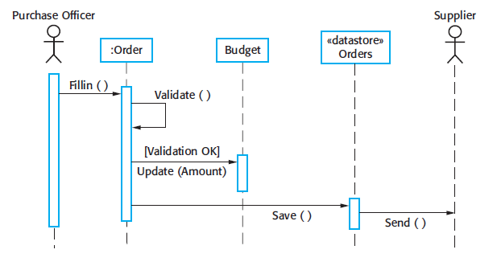
In this diagram, you can see the processing steps (represented as activities) and the data flowing between these steps (represented as objects).

Slide 33
Event-driven modeling
Event-driven modeling shows how a system responds to external and internal events.
It is based on the assumption that a system has a finite number of states and that events (stimuli) may cause a transition from one state to another.

Slide 34
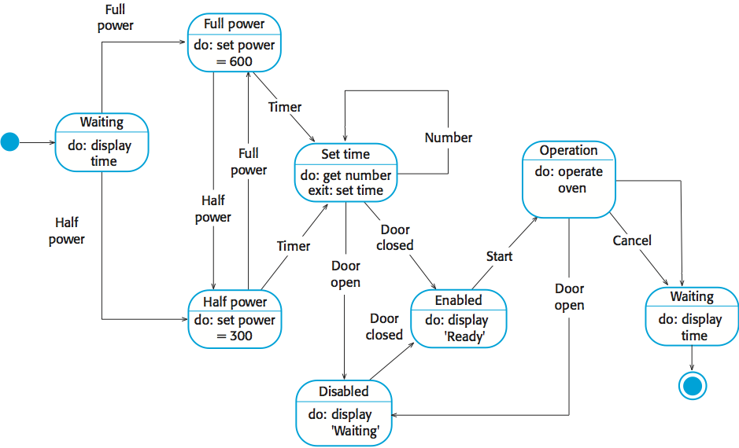
n

Slide 35
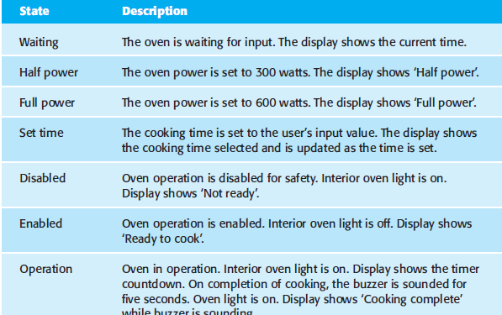

Slide 36
Object models
Object models describe the system in terms of object classes and their associations.
An object class is an abstraction over a set of objects with common attributes and the services (operations) provided by each object.
Various object models may be produced
Inheritance models;
Aggregation models;
Interaction models.

Slide 37
Inheritance models
Organise the domain object classes into a hierarchy.
Classes at the top of the hierarchy reflect the common features of all classes.
Object classes inherit their attributes and services from one or more super-classes. these may then be specialised as necessary.

Slide 38
User class hierarchy

Slide 39
Aggregation models
An aggregation is formed when an object contains one or more other objects
An example might be a computer system which contains a CPU object a hard disk object a keyboard object etc
One special form of aggregation is referred to as composition
Composition is found where the components of an object only exist within the one composite object
For example a finger belong to just one hand. Therefore it can be said that the hand finger relationship is a composite relationship

Slide 41
Interaction models

Slide 42
functional model
functional model is a structured representation of the functions (activities, actions, processes, operations) within the modelled system.
Data Flow Diagram
Data Dictionary

Slide 43
Data Flow Diagram
A Data Flow Diagram (DFD) is a traditional visual representation of the information flows within a system.
It shows how data enters and leaves the system, what changes the information, and where data is store

Slide 44

Entities - Entities are source and destination of information data. Entities are represented by a rectangles with their respective names.
Process - Activities and action taken on the data are represented by Circle or Round-edged rectangles.
Data Storage - There are two variants of data storage - it can either be represented as a rectangle with absence of both smaller sides or as an open-sided rectangle with only one side missing.
Data Flow - Movement of data is shown by pointed arrows. Data movement is shown from the base of arrow as its source towards head of the arrow as destination.

Slide 45
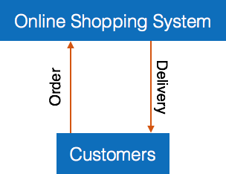
Levels of DFD
Highest abstraction level DFD is known as Level 0 DFD

Slide 46
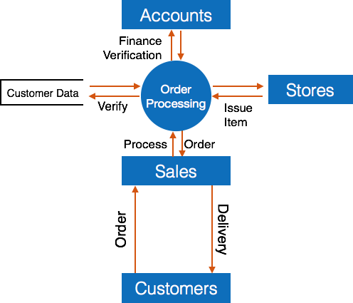
Level 1 - The Level 0 DFD is broken down into more specific

